Slide 1



Kotlin
Jvm
Kerem Akkaya

Slide 2
Kotlin Powers
Concise
Interoperable
Tool Friendly
Ant
Maven
Gradle

Slide 3
Server Side Development
Spring supports from version 5.0
Spring Boot
Vert.x for reactive Web Applications
Amazon Web Services
Google Cloud Platform
Heroku
HttpServlet

Slide 4
Android
JDK 6 support on Kotlin
Android Studio Plugin
Kotlin Android Extensions – findByViewId()
Anko
Performance
Inline functions
Lambdas
Incremental Builds Faster
Kotlin Koan

Slide 5
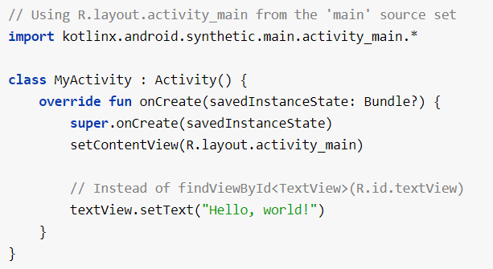
Kotlin Android Extensions

Slide 6
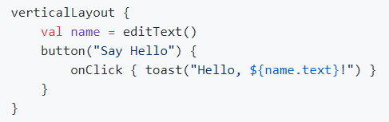
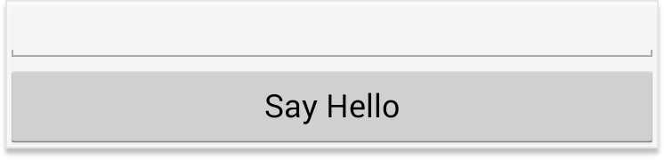
Anko

Slide 7
Javascript
DOM elements
Graphics such as WebGL
Server-side technology
Node.js
jQuery or React

Slide 8
Native Interoperability
Currently in development ☹
Without any VM
IOS, embedded targets
Target Platforms
Windows (x86_64 only)
Linux
Mac OS
iOS
Android

Slide 9
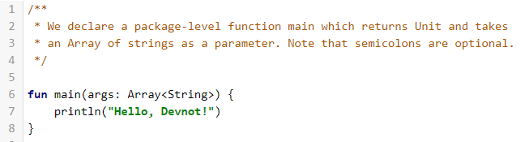

Hello Devnot - Main

Slide 10
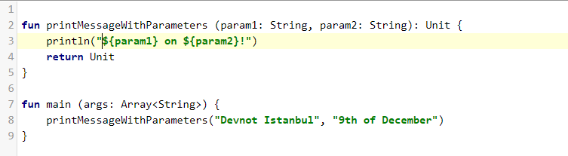
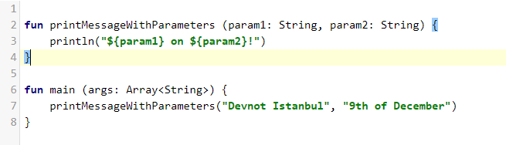

Hello World – Call Function

Slide 11
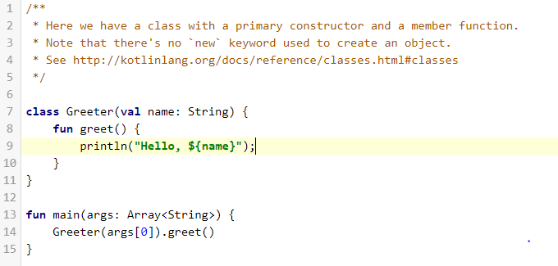

Hello World - Class

Slide 12
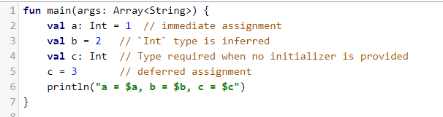

Variables Assign-once (read-only)

Slide 13
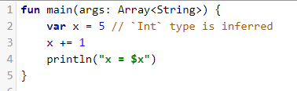

Variables - Mutable

Slide 14
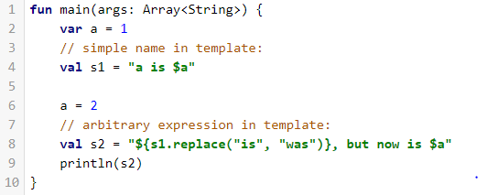

String Templates

Slide 15
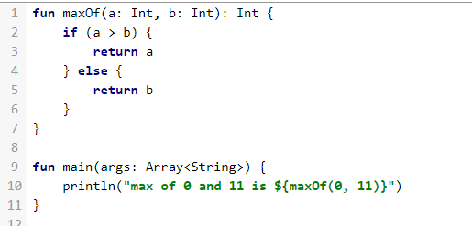
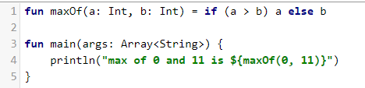

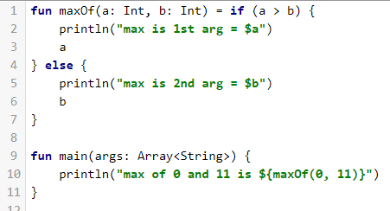

Conditional Expressions - If

Slide 16
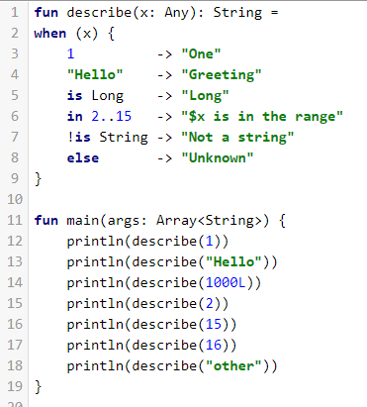
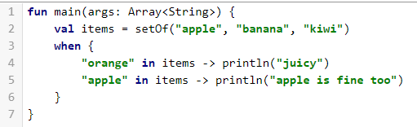

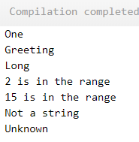
Conditional Expressions – When (No Switch)

Slide 17
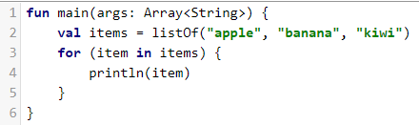

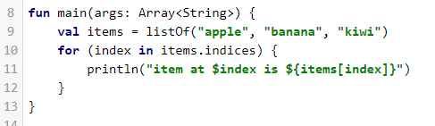
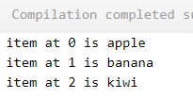
Loops - For

Slide 18
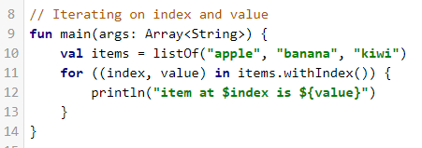
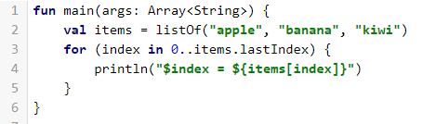
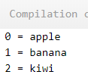
Loops - For

Slide 19
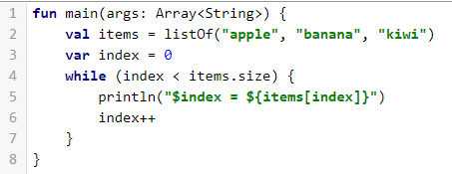
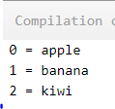
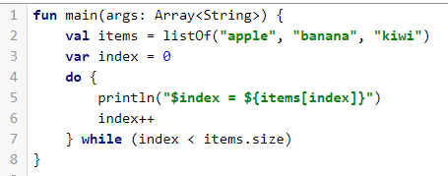
Loops – While and Do

Slide 20
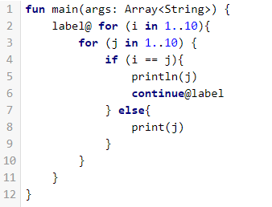
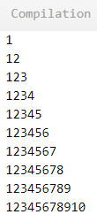
Return, break, continue

Slide 21
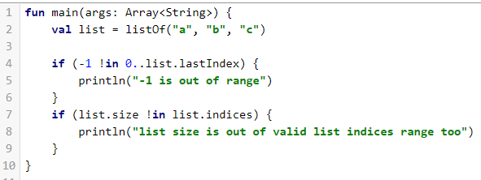

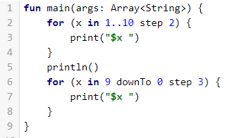
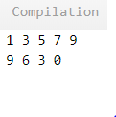
Ranges

Slide 22

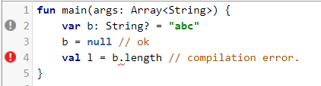
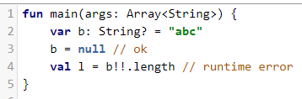
Nullables - ?

Slide 23
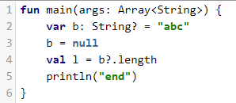

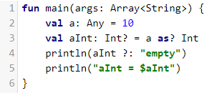

Safe Calls – Safe Casts

Slide 24
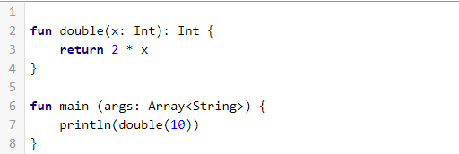

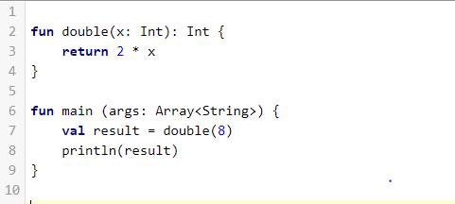

Functions - fun

Slide 25
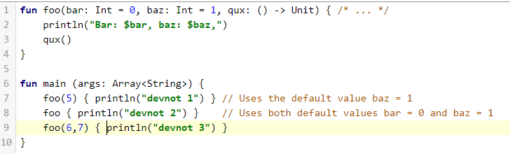
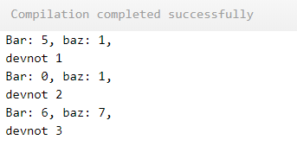
Functions – Default Arguments

Slide 26
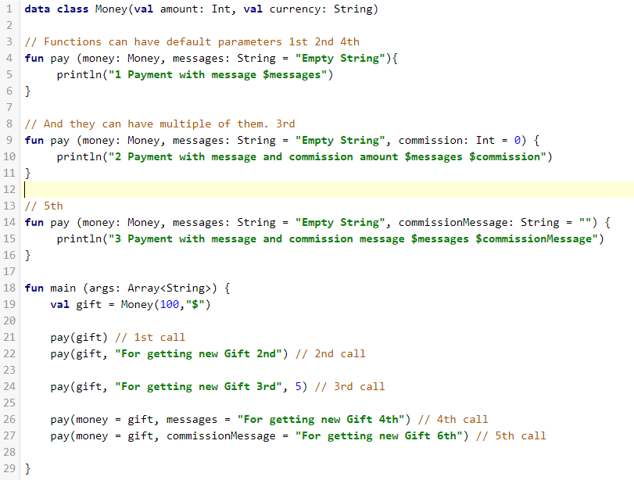
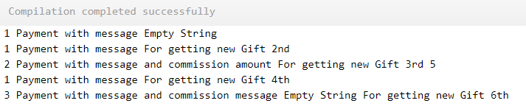
Functions - Default Arguments

Slide 27
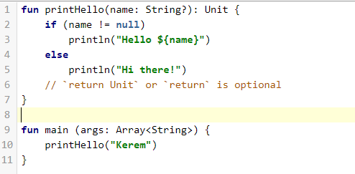

Unit-returning functions

Slide 28
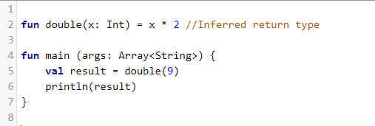

Single-Expression functions

Slide 29
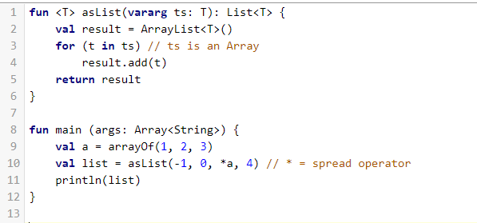

Variable Number of Arguments

Slide 30
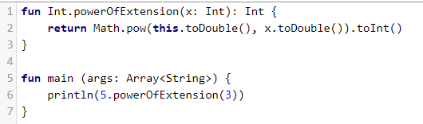

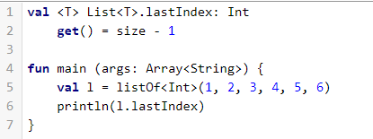

Extension Function

Slide 31
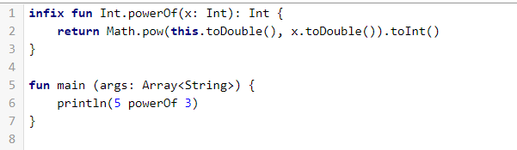
Infix Operator

Slide 32
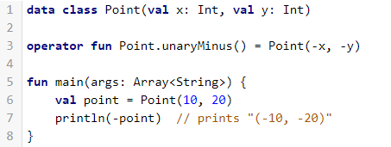

Operator Overloading
Expression | Translated to
+a | a.unaryPlus()
-a | a.unaryMinus()
!a | a.not()
a++ | a.inc()
a-- | a.dec()
a + b | a.plus(b)
a - b | a.minus(b)
a * b | a.times(b)
a / b | a.div(b)
a % b | a.rem(b), a.mod(b) (deprecated)
a..b | a.rangeTo(b)
a in b | b.contains(a)
a !in b | !b.contains(a)
a == b | a?.equals(b) ?: (b === null)
a != b | !(a?.equals(b) ?: (b === null))
a > b | a.compareTo(b) > 0
a < b | a.compareTo(b) < 0
a >= b | a.compareTo(b) >= 0
a <= b | a.compareTo(b) <= 0
Expression | Translated to
a += b | a.plusAssign(b)
a -= b | a.minusAssign(b)
a *= b | a.timesAssign(b)
a /= b | a.divAssign(b)
a[i] | a.get(i)
a[i, j] | a.get(i, j)
a[i_1, ..., i_n] | a.get(i_1, ..., i_n)
a[i] = b | a.set(i, b)
a[i, j] = b | a.set(i, j, b)
a[i_1, ..., i_n] = b | a.set(i_1, ..., i_n, b)

Slide 33
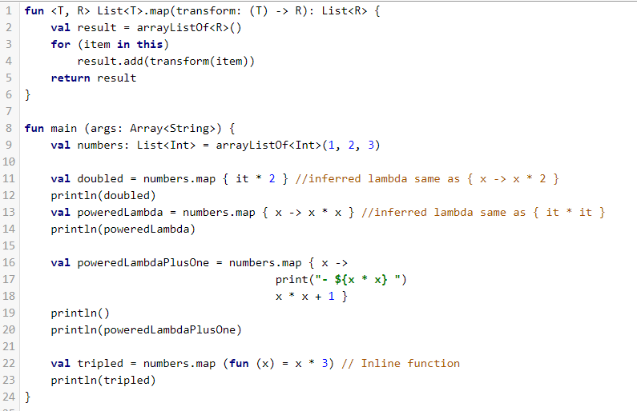
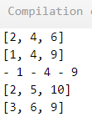
Lambda Functions

Slide 34
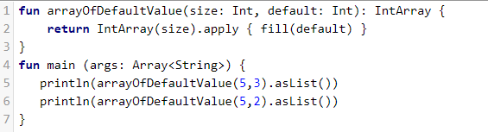

Builder-style usage of methods that return Unit

Slide 35


Inline Functions

Slide 36



Classes

Slide 37


Classes - Constructors

Slide 38



Classes Constructors

Slide 39
Visibility Modifiers
public
private
internal
protected

Slide 40


Getters and Setters

Slide 41

Getters and Setters

Slide 42

Data Class

Slide 43


Object Oriented Support

Slide 44



Interfaces

Slide 45

Interfaces – Resolve Override Conflicts

Slide 46


try/catch expression

Slide 47


With

Slide 48



Object Expressions

Slide 49

Object Expressions

Slide 50


No static - Companions

Slide 51


Type Aliases

Slide 52


Chunked, windowed

Slide 53


Smart Casts

Slide 54


Java vs Kotlin
Kotlin:
Java:

Slide 55


Java vs Kotlin
Kotlin:
Java:

Slide 56
References
https://kotlinlang.org
https://try.kotlinlang.org
https://developer.android.com/samples/index.html?language=kotlin
https://developer.android.com/kotlin/resources.html

Slide 57
Thanks
Introduction To Kotlin
Kerem Akkaya

